Slide 1
Forensic Archaeology / Anthropology
Ch 8 – Pgs 99-117
“There is a brief but very informative biography of an individual contained within the skeleton, if you know how to read it…”
—Clyde Snow, Forensic Anthropologist

Slide 2
Defining Forensic Anthropology
Forensic anthropology is a type of “applied anthropology” that specializes in the changes and variations in the human skeleton for the purpose of legal inquiry.
2. Forensic Anthropologists with expertise in archaeological methods play an important role in the recovery of human remains.

Slide 3
Field of Forensic Anthropology
3. The need emerged for the investigation of death and injury for criminal purposes
4. They are trained to understand the forms and variations of the human skeleton in individuals and populations.
    complements the pathologists emphasis on soft tissue.

Slide 4
Branches of Forensic Anthropology
1. Interpretation of primarily outdoor death scenes and postmortem processes - Forensic Taphonomy
2. Recovery of scattered or buried remains – Forensic Archaeology
3. Extrapolation of soft tissue based on skeletal form
4. Biochemical interpretation of sharp and blunt force injuries, primarily to the bone

Slide 5
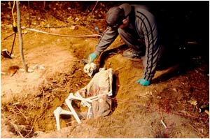
Examination of Human Remains
Identifying the victim or at least providing a biological profile
Reconstructing the postmortem period based on the condition of the remains
Providing data
regarding the death
event

Slide 6
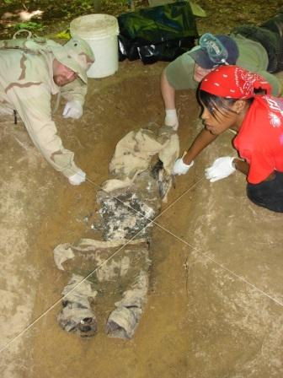
A forensic anthropologist may provide basic identification information of skeletonized or badly decomposed remains.
From a whole bone or part of a bone, the scientist may be able to determine:
        An age range
        Sex
        Race
        Approximate height
        Cause of death, disease, or anomaly

Slide 7
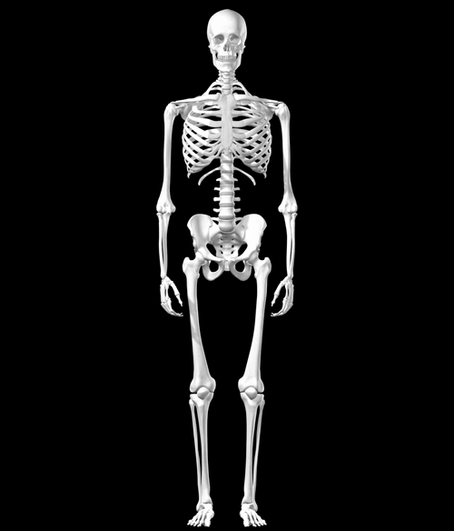
Osteology
Study of bones
206 bones in an adult human
Function of bones:
  Provides structure and rigidity
  Protects soft tissue and organs
  Serves as an attachment for muscles
  Produces blood cells
  Serves as a storage area for minerals
  Can detoxify the body by removing heavy metals and other foreign elements from the blood

Slide 8
Age Determination
Most accurate estimations from:
  Teeth
  Pubic symphysis
  Epiphyses or growth plates
  Cranial sutures: the three major cranial sutures appear as distinct lines in youth and gradually close from the inside out.
Investigators always use an age range because of the variation in people and how they age.The investigator does not want to eliminate any possibilities for identification.

Slide 9
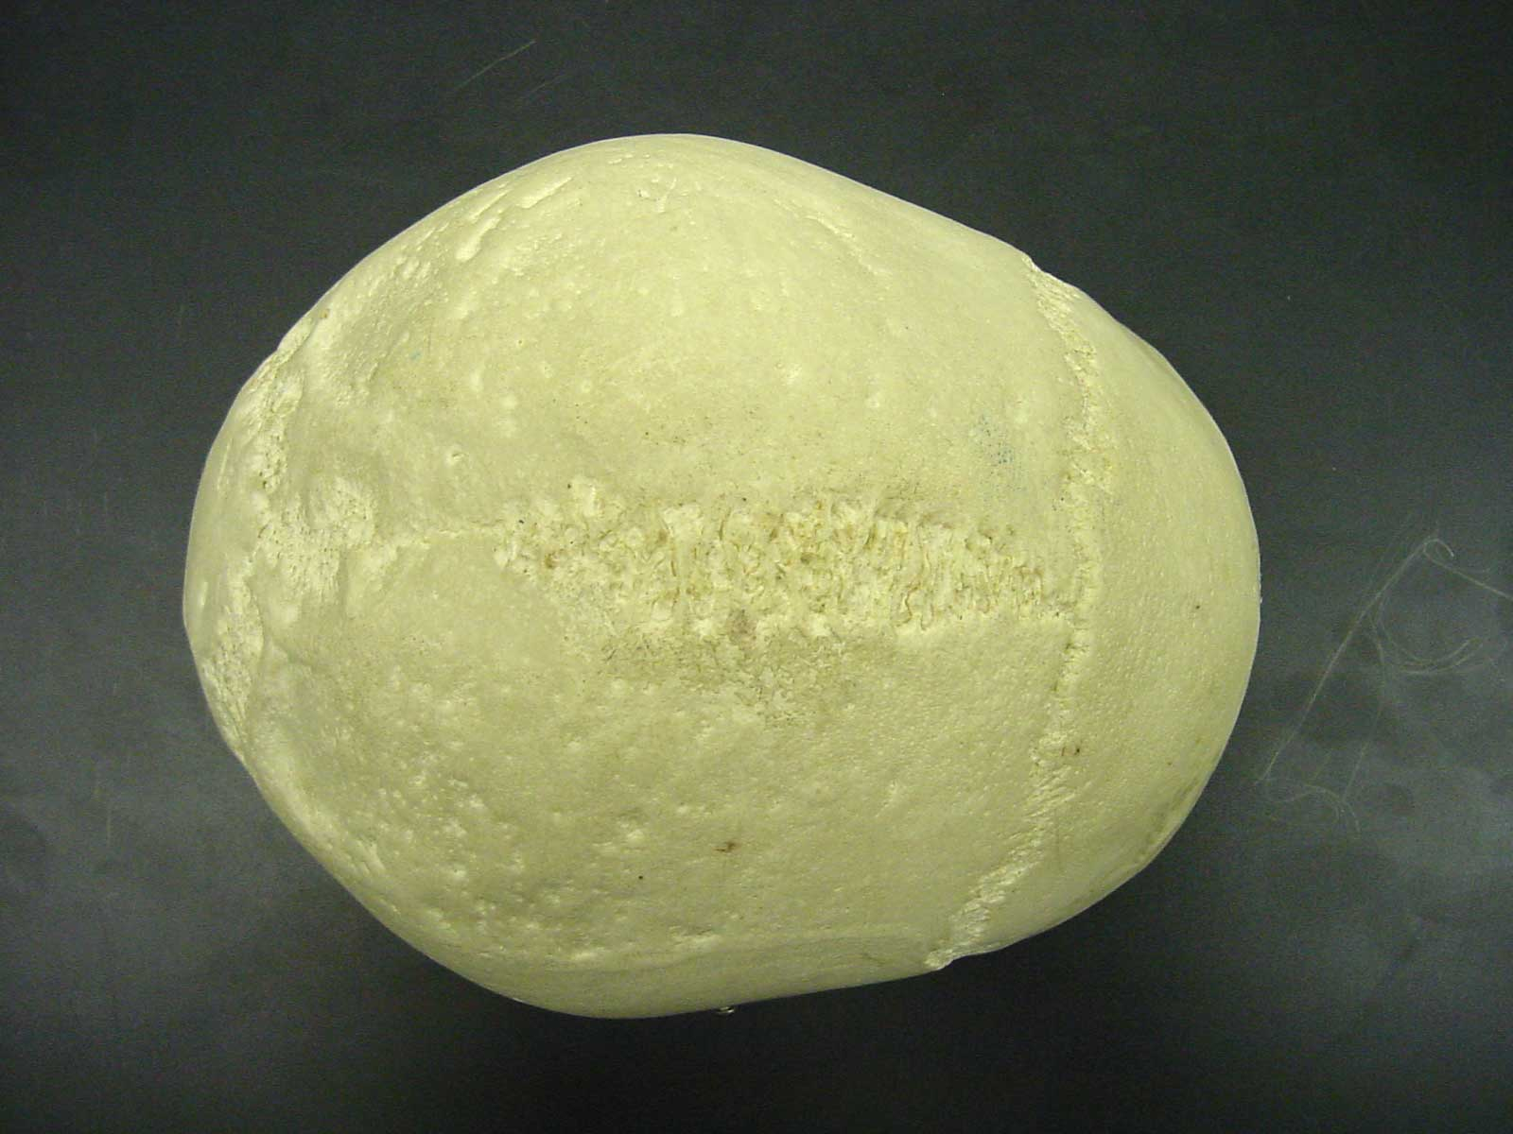
Age Determination Using Cranial Sutures
Sagittal suture
Sagittal suture completely closed
  Males—26 or older
  Female—29 or older
Sagittal suture is complete open
  Male—less than 32
  Female—less than 35
Complete closure of all three major sutures
  Male—over 35
  Female—over 50
Lambodial
Coronal

Slide 10
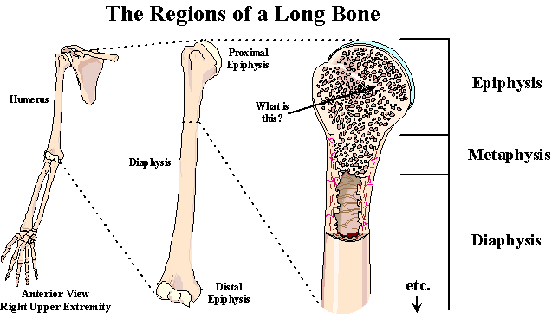
Age Determination Using Epiphysis

Slide 11
Stage of Union of Medial Clavicle | Male | Female
Non-union without separate epiphysis | 21 or younger | 20 or younger
Non-union with separate epiphysis | 16-21 | 17-20
Partial union | 17-30 | 17-33
Complete union | 21 or older | 20 or older

Slide 12
Age Determination Using Epiphysis
Stage of Union of the Iliac Crest | Male | Female
Non-union without separate epiphysis | 16 or younger | 11 or younger
Non-union with separate epiphysis | 13-19 | 14-15
Partial union | 14-23 | 14-23
Complete union | 17 or older | 18 or older

Slide 13
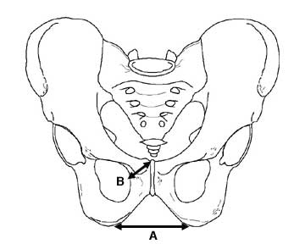
Gender Differences in Bones
The pelvis of the female is wider. Males have a narrow subpubic angle (A) and a narrow pubic body (B).

Slide 14
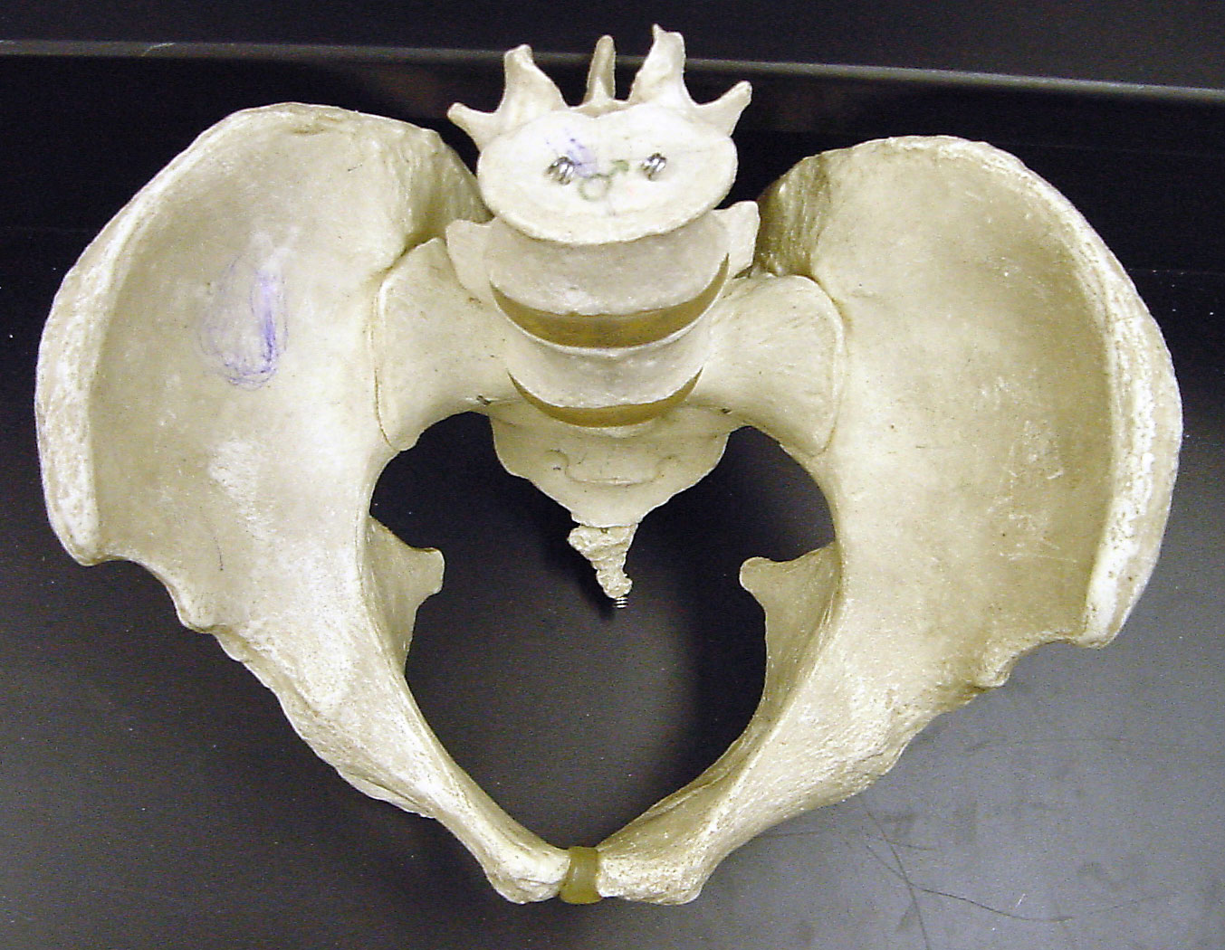
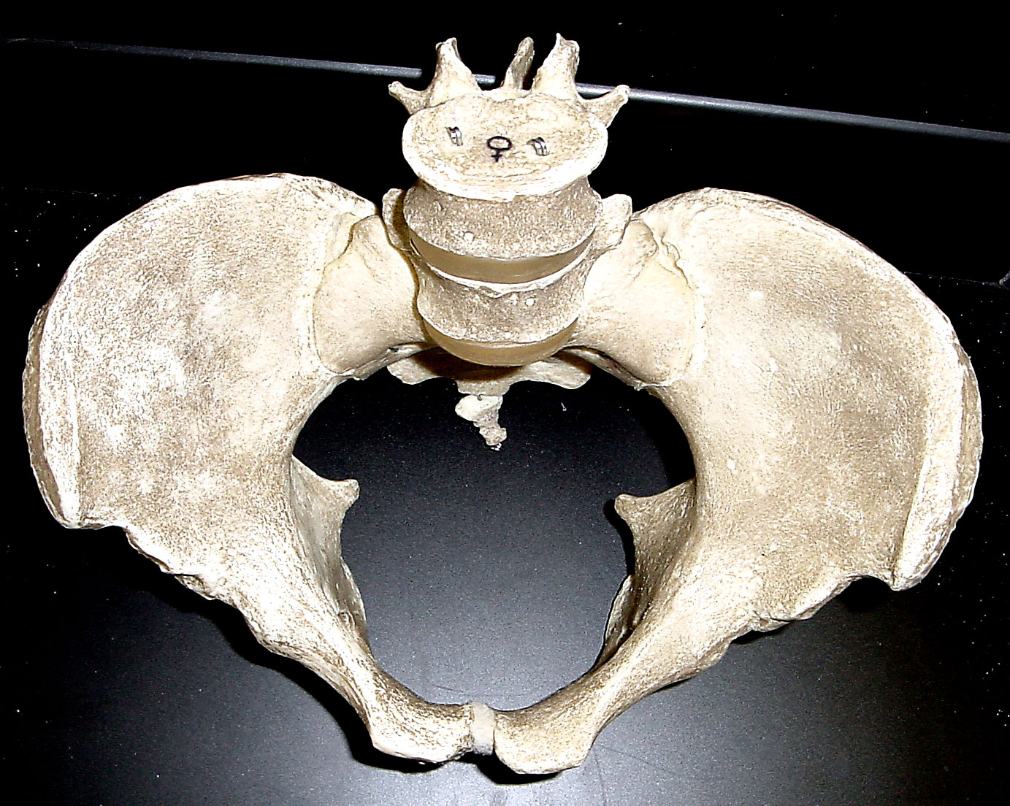
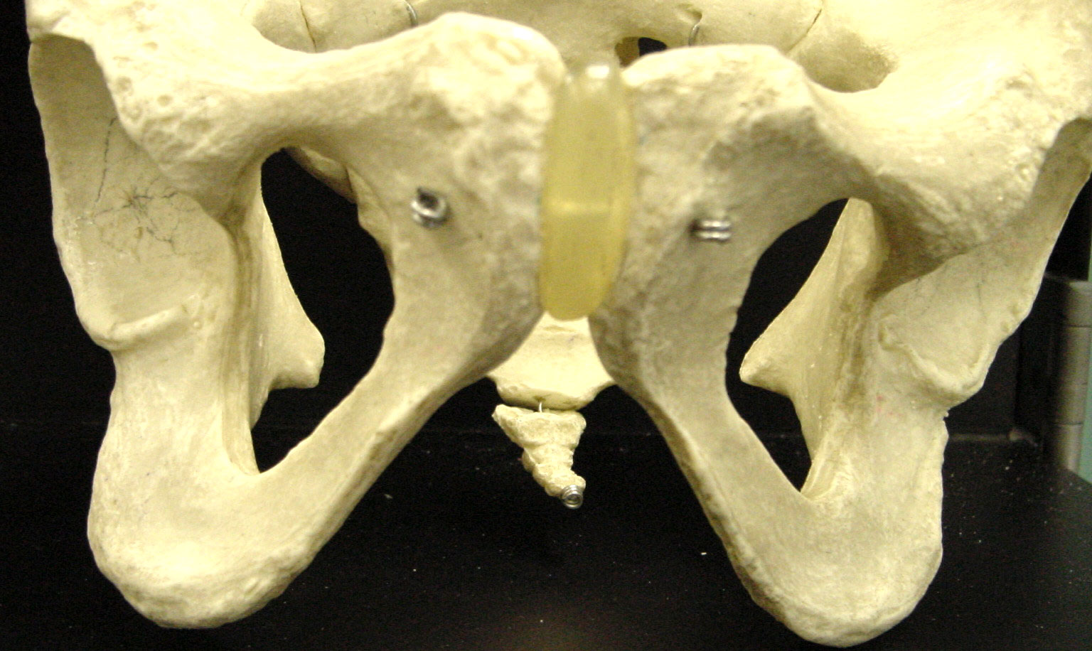
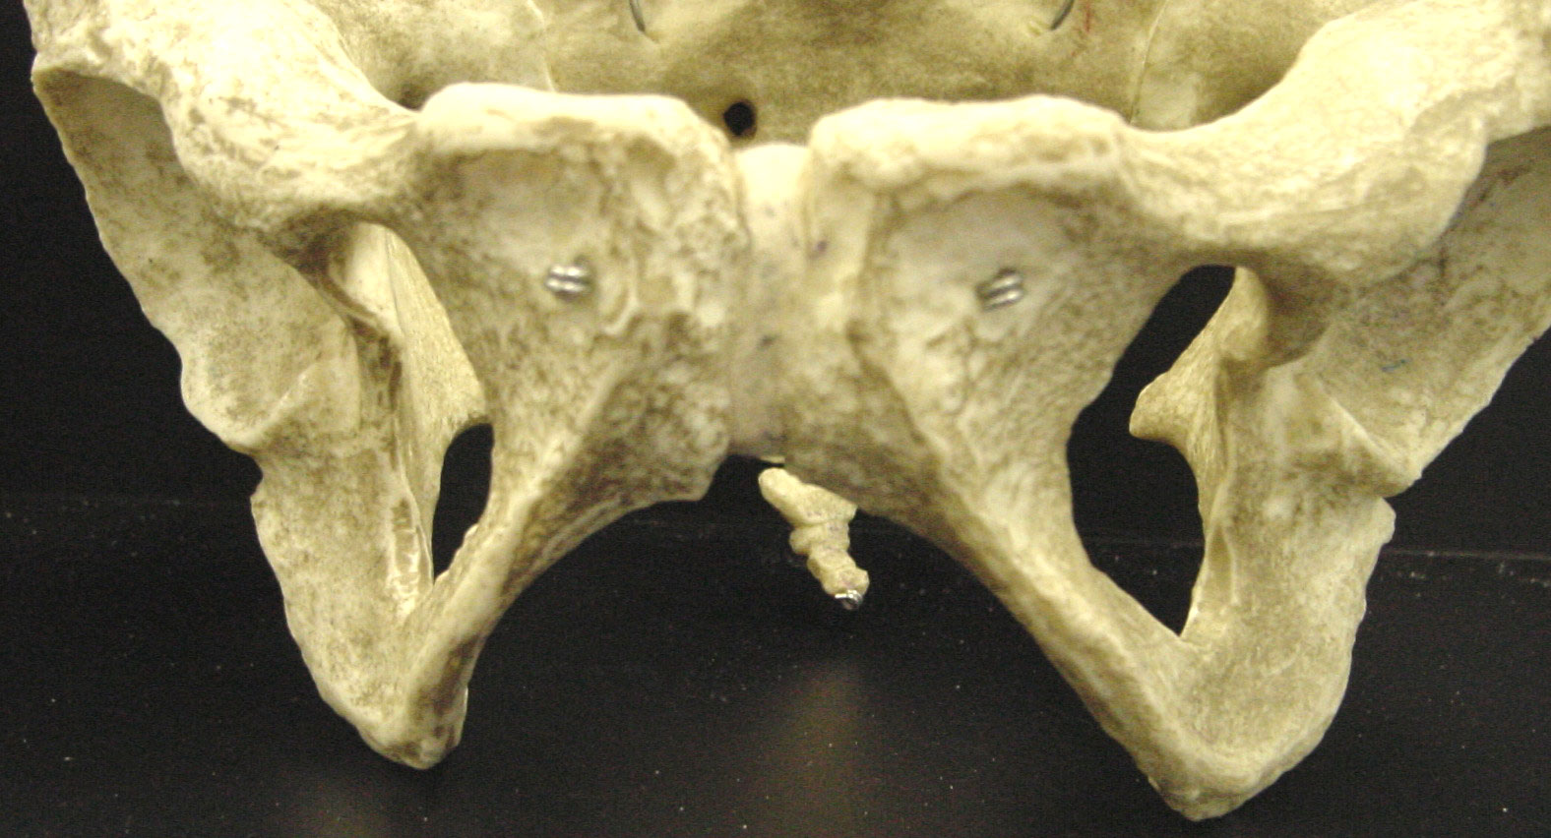
Male Female
Sub Pubic Angle

Slide 15
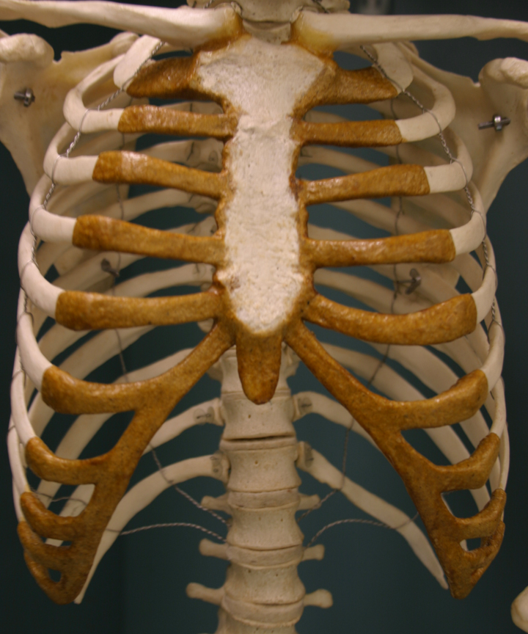
Gender Differences
The ribcage and shoulders of males are generally wider and larger than that of females. In addition, about one person in twenty has an extra rib. This is more common in males than in females.

Slide 16
Gender Differences
In males the index finger is sometimes shorter than the third finger. In females, the first finger is sometimes longer than the third finger. This is not often used as an indicator of gender as there are many exceptions.
Is this a male or female hand
according to the above rule?

Slide 17
Race
Race is difficult to determine from most skeletal remains, especially since pure races are becoming uncommon. An experienced forensic anthropologist can generally place skulls into one of three groups:
  Caucasian—European, Middle Eastern, and Indian descent
  Negroid—African, Aborigine, and Melanesian descent
  Mongoloid—Asian, Native American and Polynesian descent

Slide 18
Race Characteristics
Caucasoids—have a long, narrow nasal aperture, a triangular palate, oval orbits, narrow zygomatic arches and narrow mandibles.
Negroids—have a wide nasal aperture, a rectangular palate, square orbits, and more pronounced zygomatic arches. The long bones are longer, have less curvature and greater density.
Mongoloids—have a more rounded nasal aperture, a parabolic palate, rounded orbits, wide zygomatic arches and more pointed mandibles.

Slide 19
What differences do you notice between these three skulls? Can you determine race?

Slide 20
Estimation of Height
The height of a person can be calculated by using the length of certain long bones, including the femur, tibia, humerus, and radius. Below are the equations to determine average measurements for both male and female. (All measurements are in centimeters)
Male Female
femur x 2.23 + 69.08 femur x 2.21 +61.41
tibia x 2.39 + 81.68 tibia x 2.53 + 72.57
humerus x 2.97 + 73.57 humerus x 3.14 + 64.97
radius x 3.65 + 80.40 radius x 3.87 + 73.50

Slide 21
Facial Restoration
After determining the sex, age, and race of an individual, facial features can be built upon a skull to assist in identification. Erasers are used to make tissue depths at various points on the skull. Clay is used to build around these markers and facial features are molded.

Slide 22
Steps in Facial Reconstruction
With a skull:
  Establish age, sex and race
  Plot landmarks for tissue thickness
  Plot origin and insertion points for muscles
  Plot landmarks for facial features
  Select a dataset and mount markers for tissue thickness
  Mount the eyes
  Model muscles on skull
  Add fatty tissue around eyes and lacrimal glands
  Add eyelids
  Add the nose
  Add the parotid gland
  Add the ears
  Cover all with layers of skin
  Detail the face

Slide 23
One Final Product
John List killed his entire family, moved to a new town and assumed a new identity. Seventeen years later, Frank Bender reconstructed what he believed List would look like. It was shown on America’s Most Wanted, and he was turned in by the viewers almost immediately. . . looking very much like the reconstruction.
Check out more about this story on CourtTV’s crime library:
www.crimelibrary.com/notorious_murders/family/list/1.html

Slide 24
People in the News
Bill Bass is a forensic anthropologist who has assisted law enforcement with hundreds of cases. He established the world’s first and only laboratory devoted to the study of human decomposition at the University of Tennessee’s Anthropology Research Facility.
It is known as “the body farm.”

Slide 25
The Body Farm
The nickname of a two and a half acre research facility in Tennessee developed in 1980 by Bill Bass where bodies are placed in various conditions and allowed to decompose. Its main purpose is to observe and understand the processes and timetable of postmortem decay. Over the years it has helped to improve the ability to determine "time since death" in murder cases.
Hic locus est ubi mortui viveuntes docent.
This is the place where the dead teach the living.

Slide 26
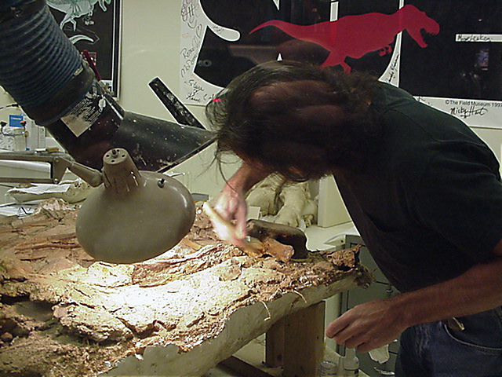
Anthropologist at Work
This anthropologist is
hard at work dusting
away material from
these imbedded bones.
Picture taken at
Chicago’s Museum
of Natural History

Slide 27
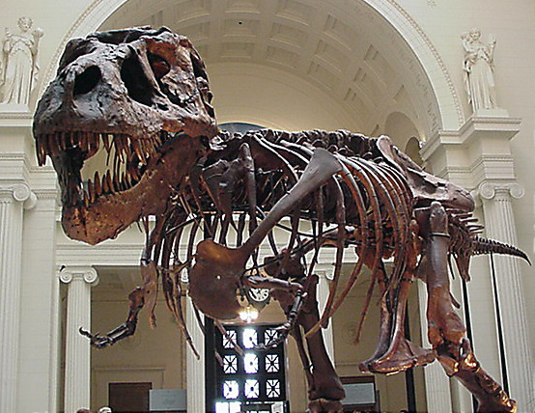
More Applications
Forensic experts may be called upon
to give information on the life and death
of humans and animals in unique
circumstances, including:
      Mass Murder (Oklahoma bombing, plane crashes, World Trade)
      Earlier man (mummies, Iceman, Lindow man)
      Historical Significance (Holocaust, uncertain death of famous people)
      Prehistoric Animals (Dinosaurs)

Slide 28
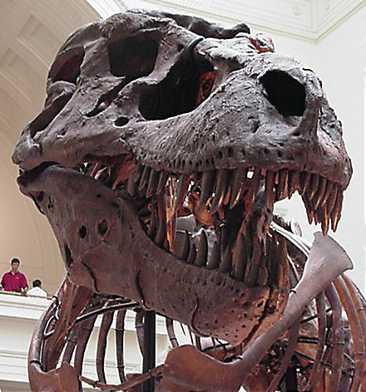
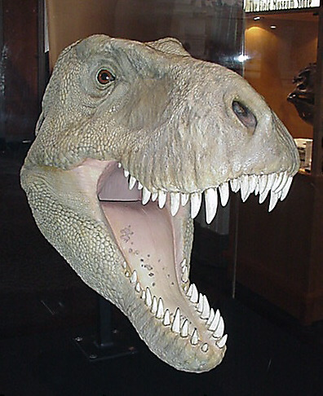
Animal Facial Restoration
Determining what T Rex looked like using the bone formation.
From this: To this:

Slide 29
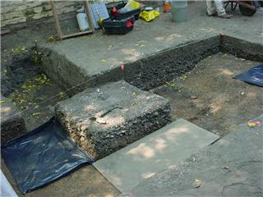
Forensic Archaeology
Uses and methods of Archeologists to uncover remains
  Remote Sensing
  Precise Mapping w/Spatial Relationships
  Evacuation methods
  Complete documentation of soils and artifacts

Slide 30
Scene Processing
Locating Remains:
  Participates in searches with law enforcement
  Done in unison with search and rescue teams, cadaver dogs, or divers.
The archaeologist, forensic anthropologist or coroner usually does on-site identification of remains to determine of they are human.

Slide 31
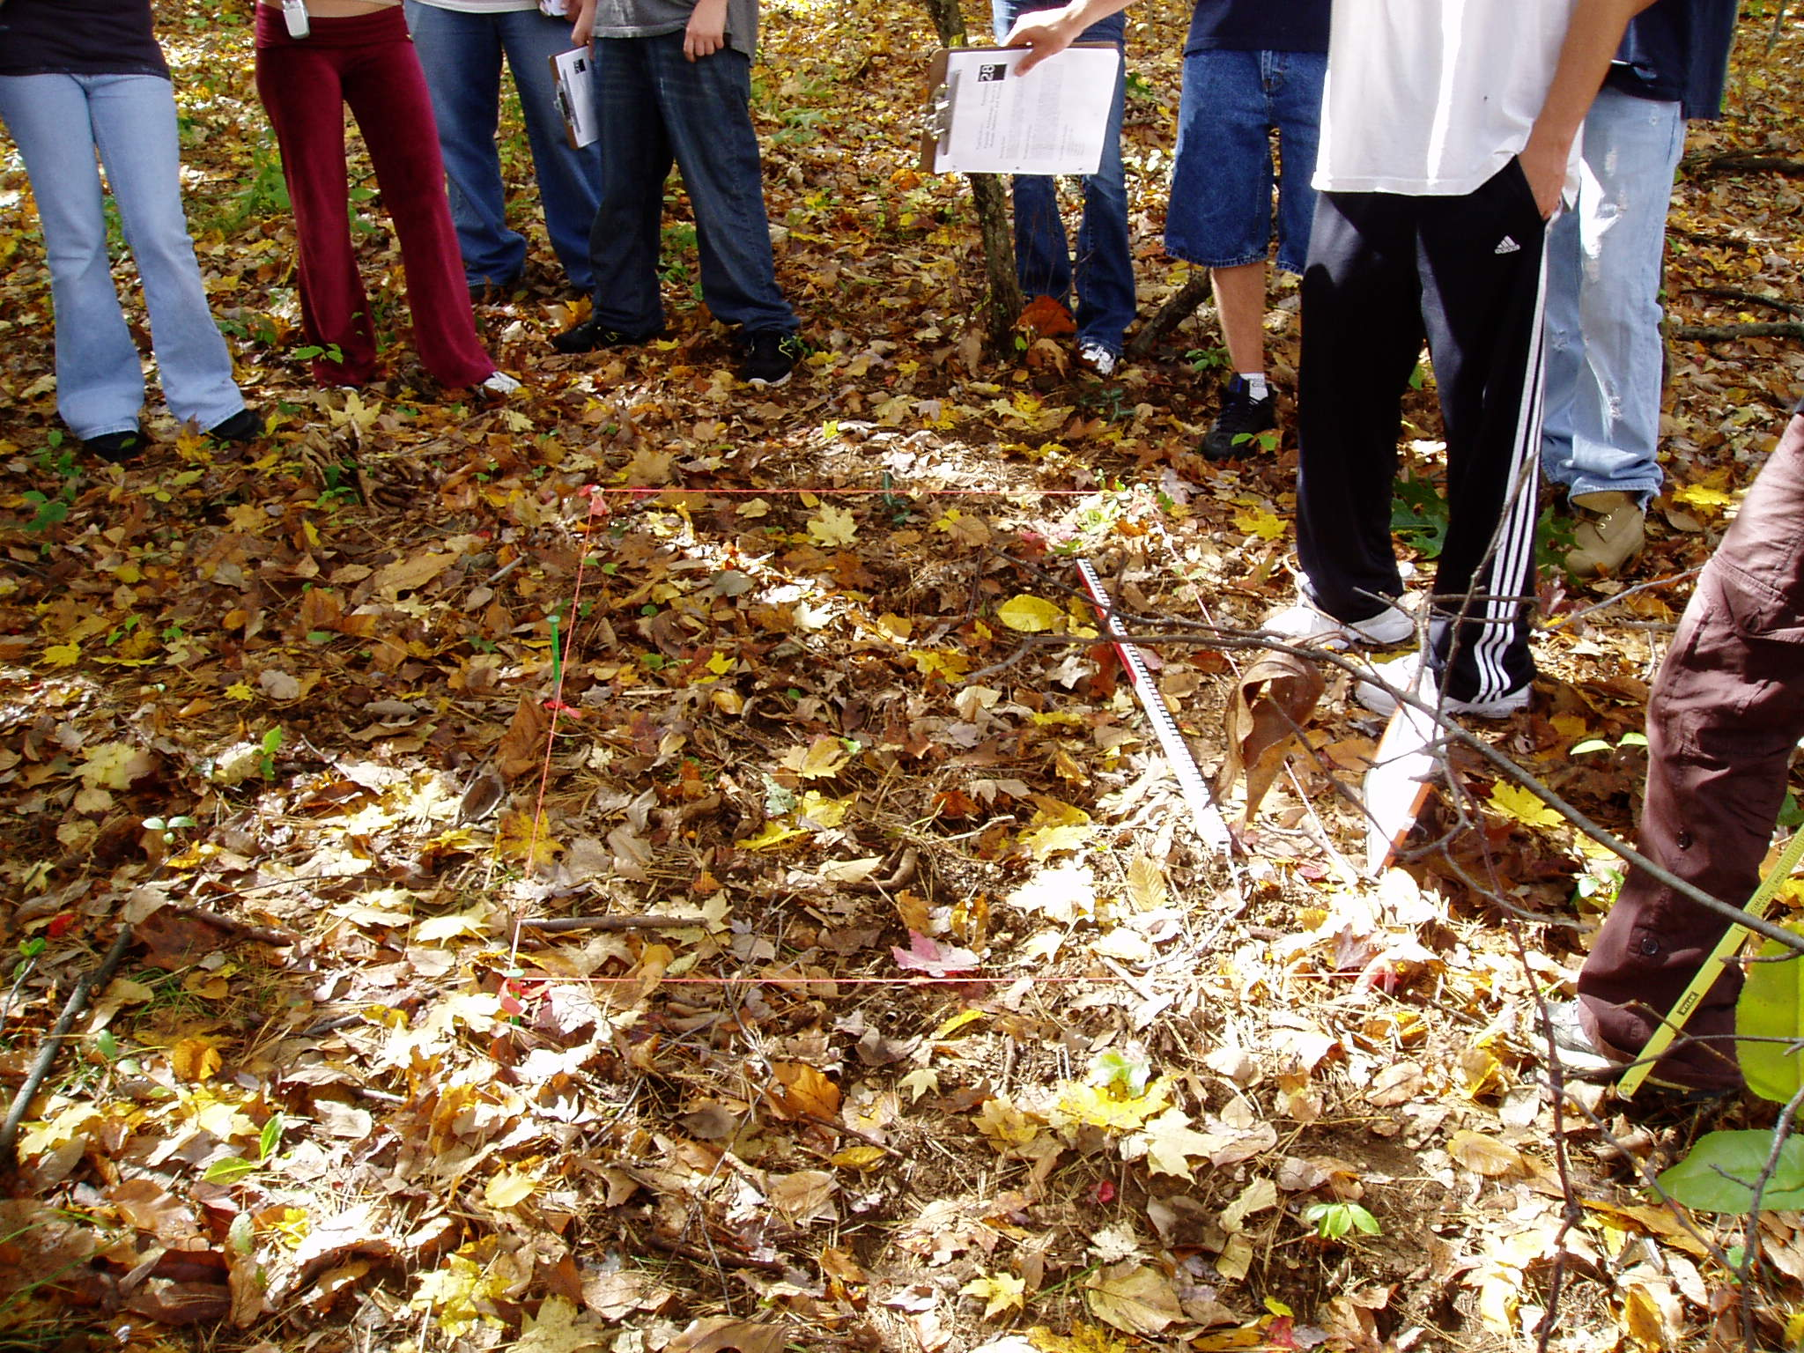
Buried Remains
Access to and within the scene need to be well marked and limited.
The area surrounding the site should be processed for other evidence.

Slide 32
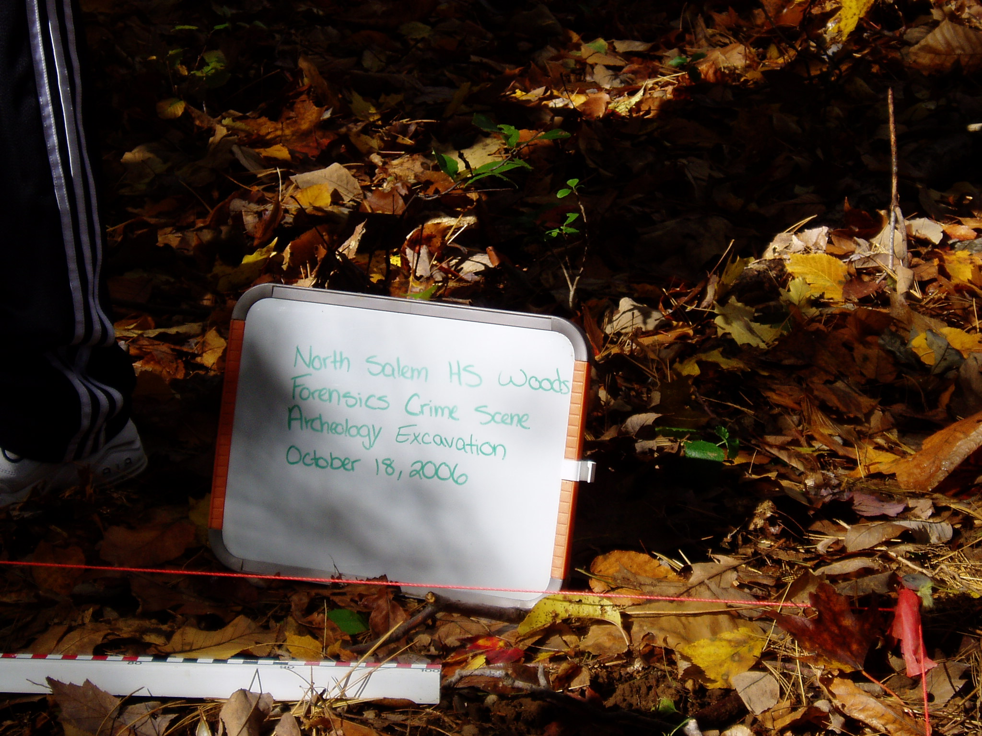
Initial Steps
Area must be gridded
Entire area photographed and documented
Metal detector – (optional)
Area is examined for insects, or larvae, associated with the a decomposing body

Slide 33
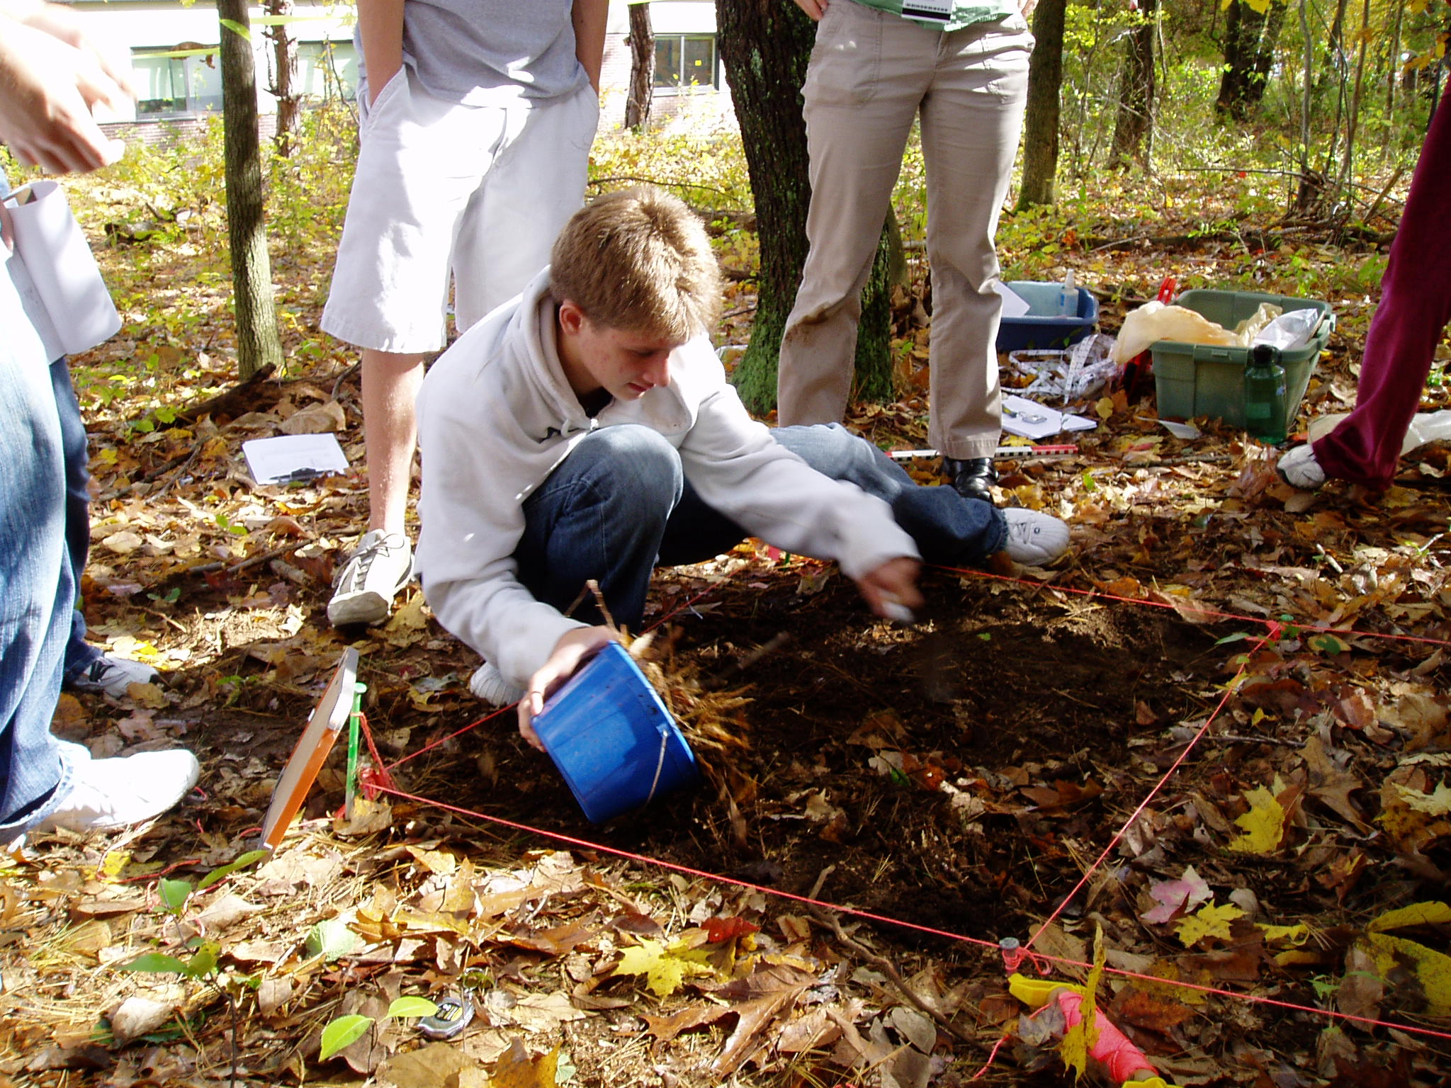
Next....
A screening area is set up – somewhere away from the initial site
Clear the area for digging
Leaf cover is removed and screened
Dirt is removed and screened – section by section

Slide 34
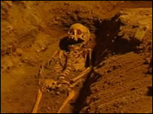
Finally...
The remains are excavated – sometimes from the side to preserve the stratification patterns
  Trowels and brushes are used
  All evidence on the body is collected and packaged
All sediment is screened
Photographs are taken at regular intervals
The body should be completely exposed before removing

Slide 35
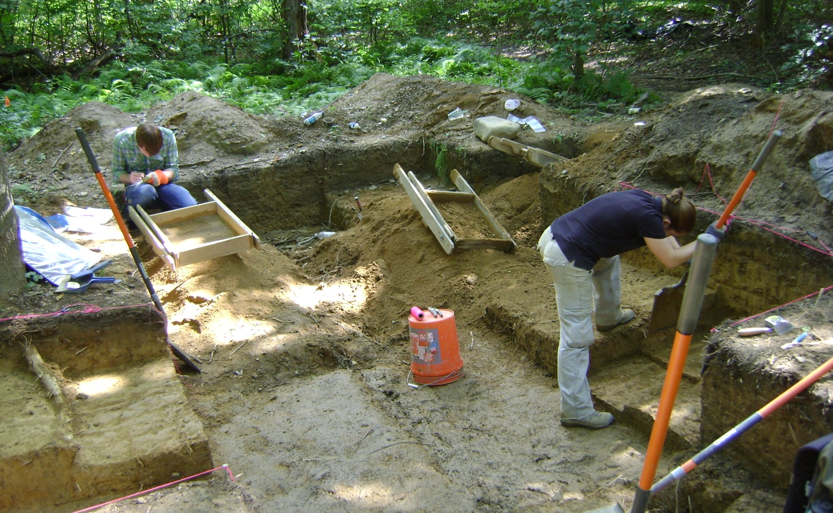
Notes:
35

Slide 36
POINT PROVIENCE MAPPING
Carefully mapping artifacts on an X, Y, and Z axis to assign Strata and relative date
Provides the ability to recreate and preserve the find
Notes:
36

Slide 37
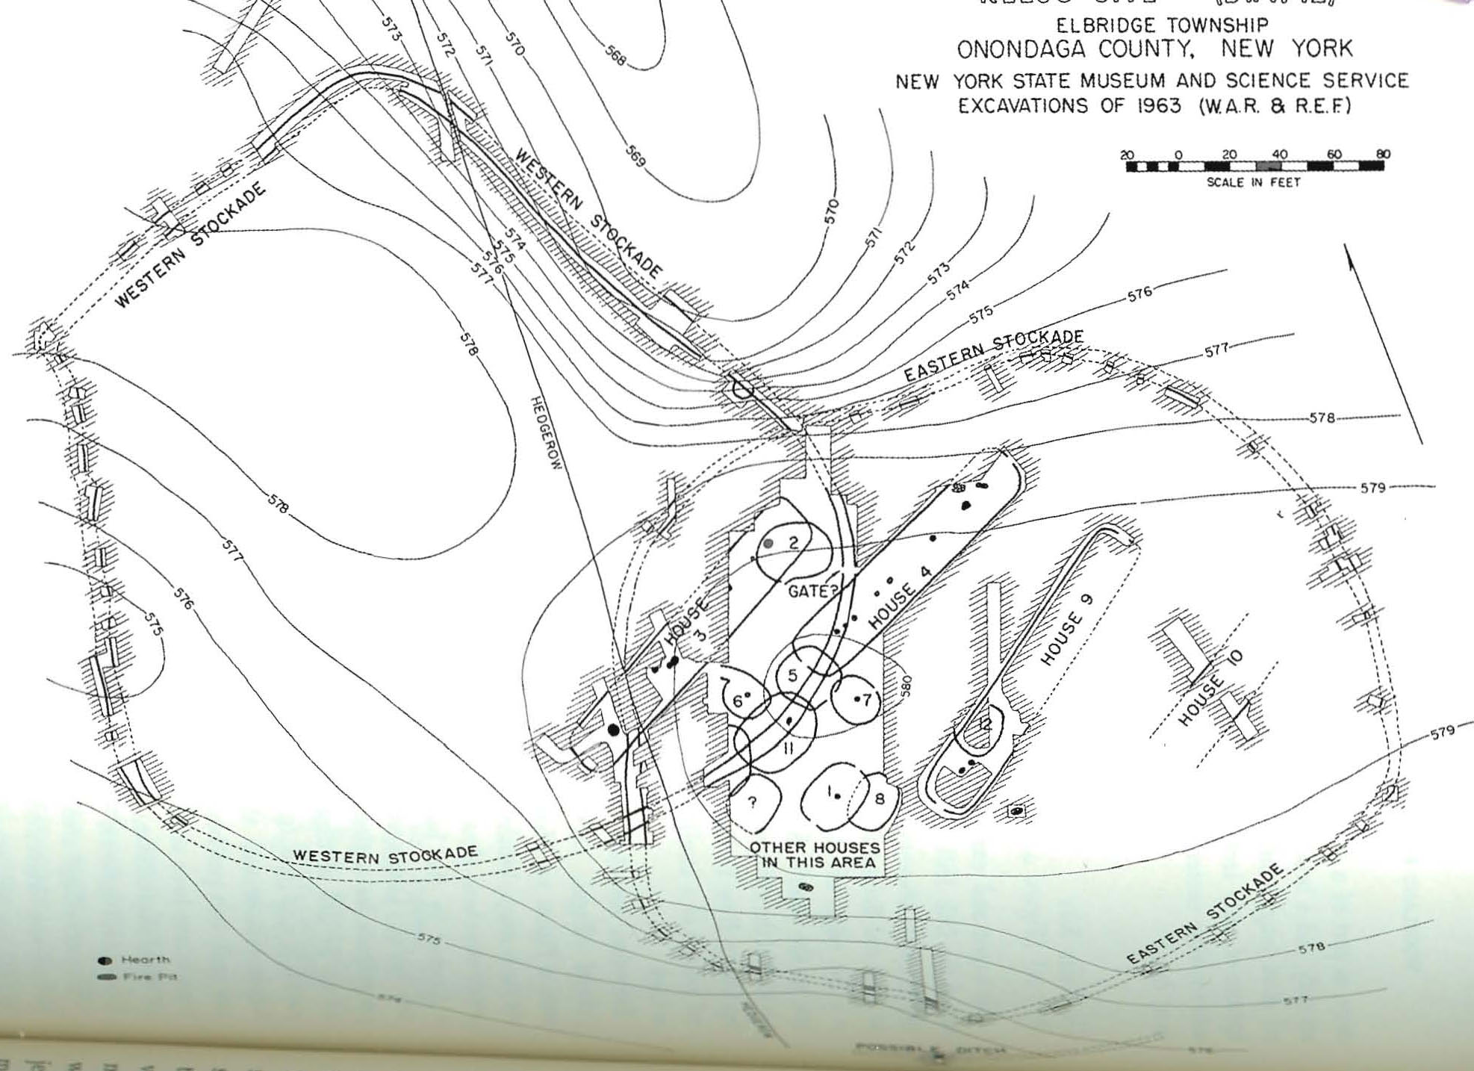
MAPS
Notes:
37

Slide 38
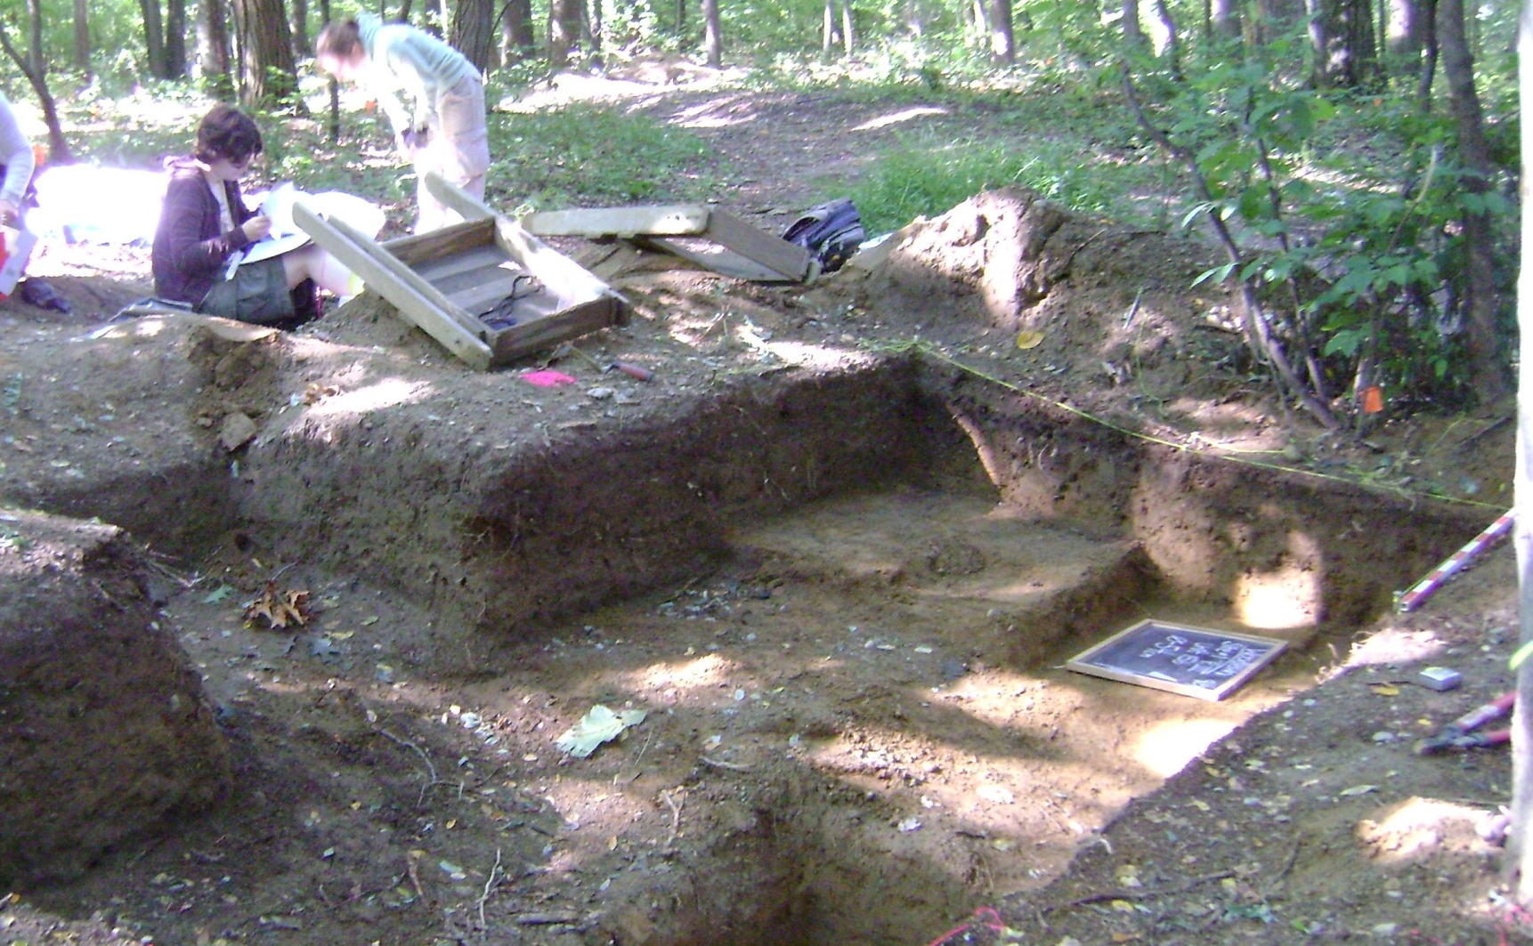

Slide 39
FLOTATION ANALYSIS
Collection of soil samples for macro-botanical recovery
Soils are carefully “floated” in water.
The lighter fraction (Seeds, pollens, diatomes, phytoliths) float to surface.
Fraction is sorted and examined to identify genre, family or species
Notes:
39

Slide 40
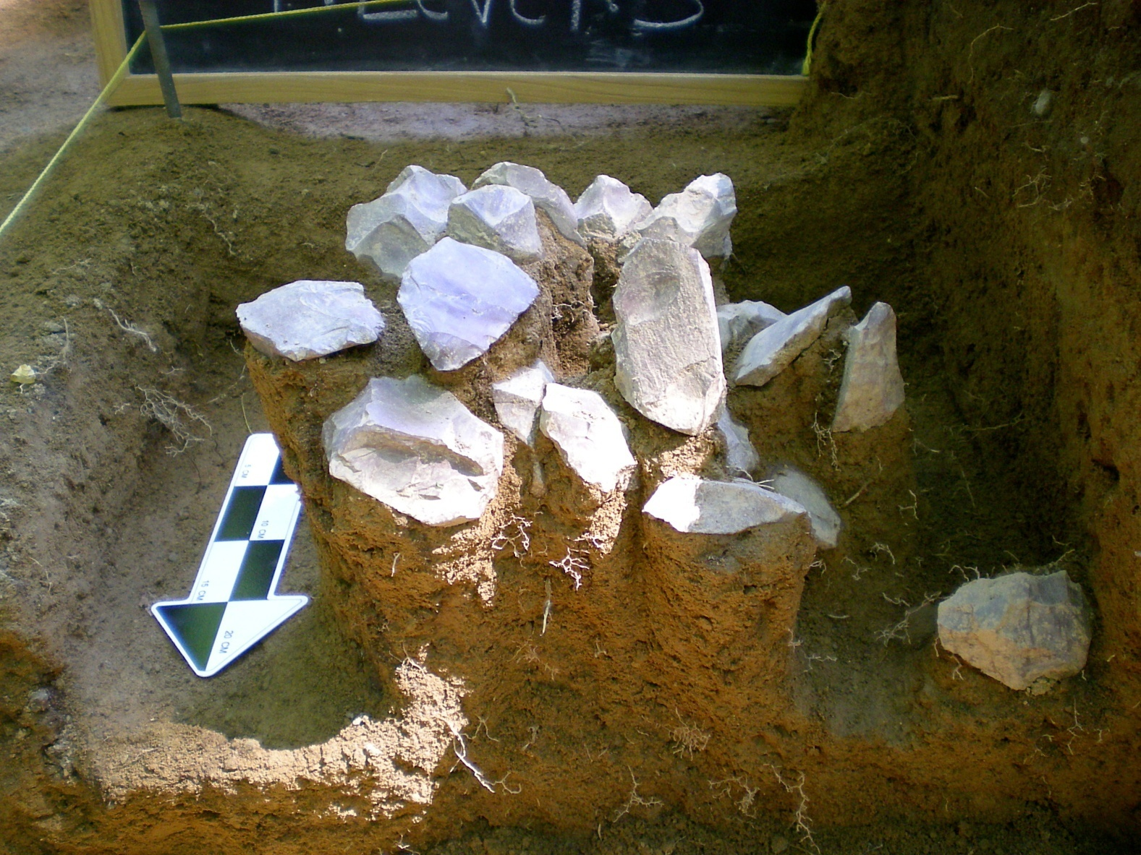
PEDESTALING
Notes:
40

Slide 41
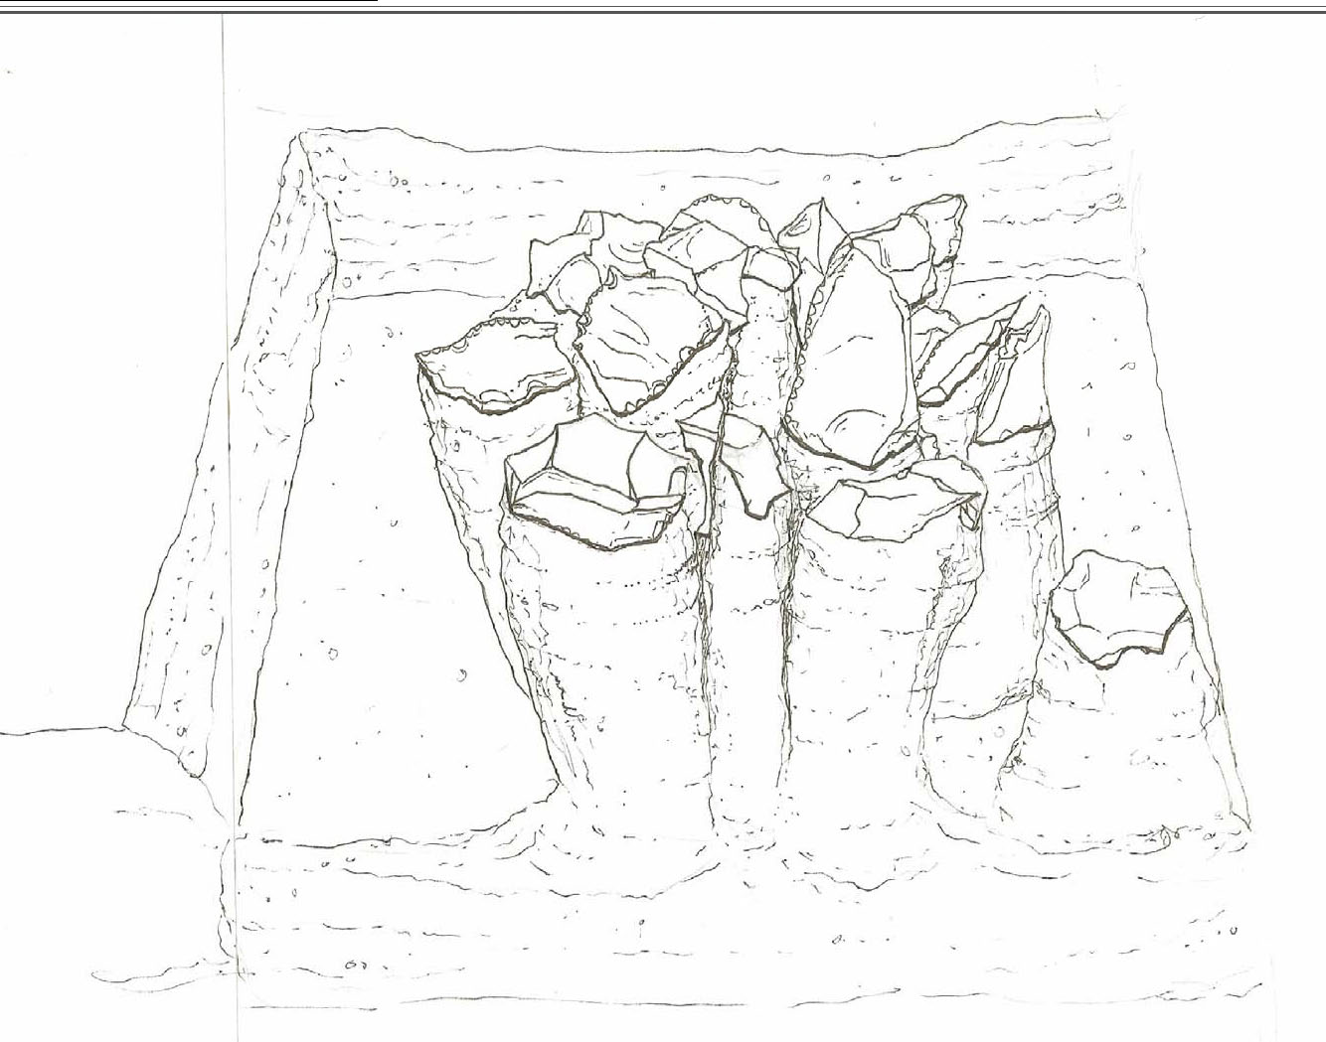
THE CAREFUL EXCAVATION OF SURROUNDING SOILS TO EXPOSE ARTIFACTS IN THEIR ENTIRETY.
Notes:
41

Slide 42
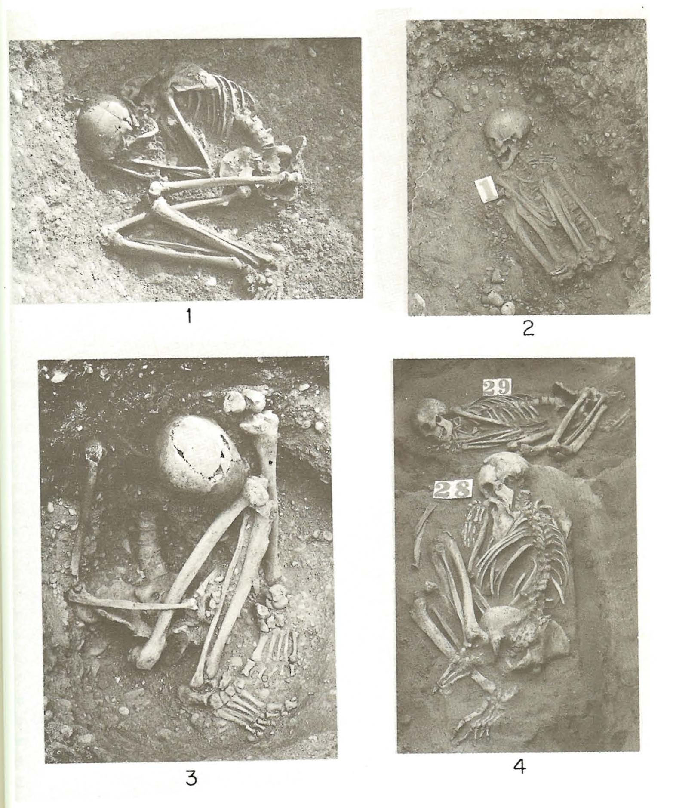
BURIALS
Notes:
42

Slide 43
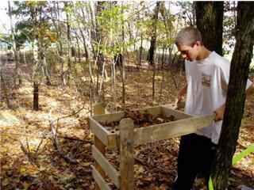
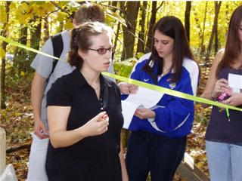
Pictures from Last Year
Mrs. Elizabeth Selig – Instructing students
Student screening for artifacts

Slide 44
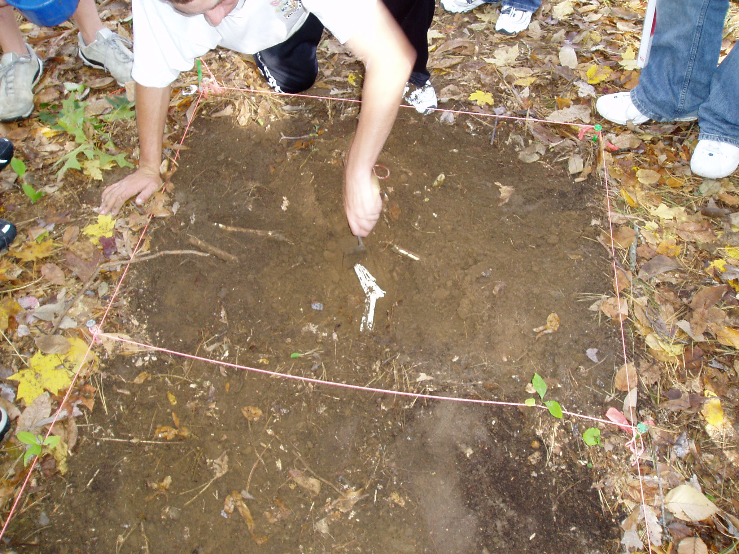
More Pics
The site has to ‘squared’ off, and lined with string. This is so the measurements are accurate, and it helps the sketcher make precise representations.

Slide 45
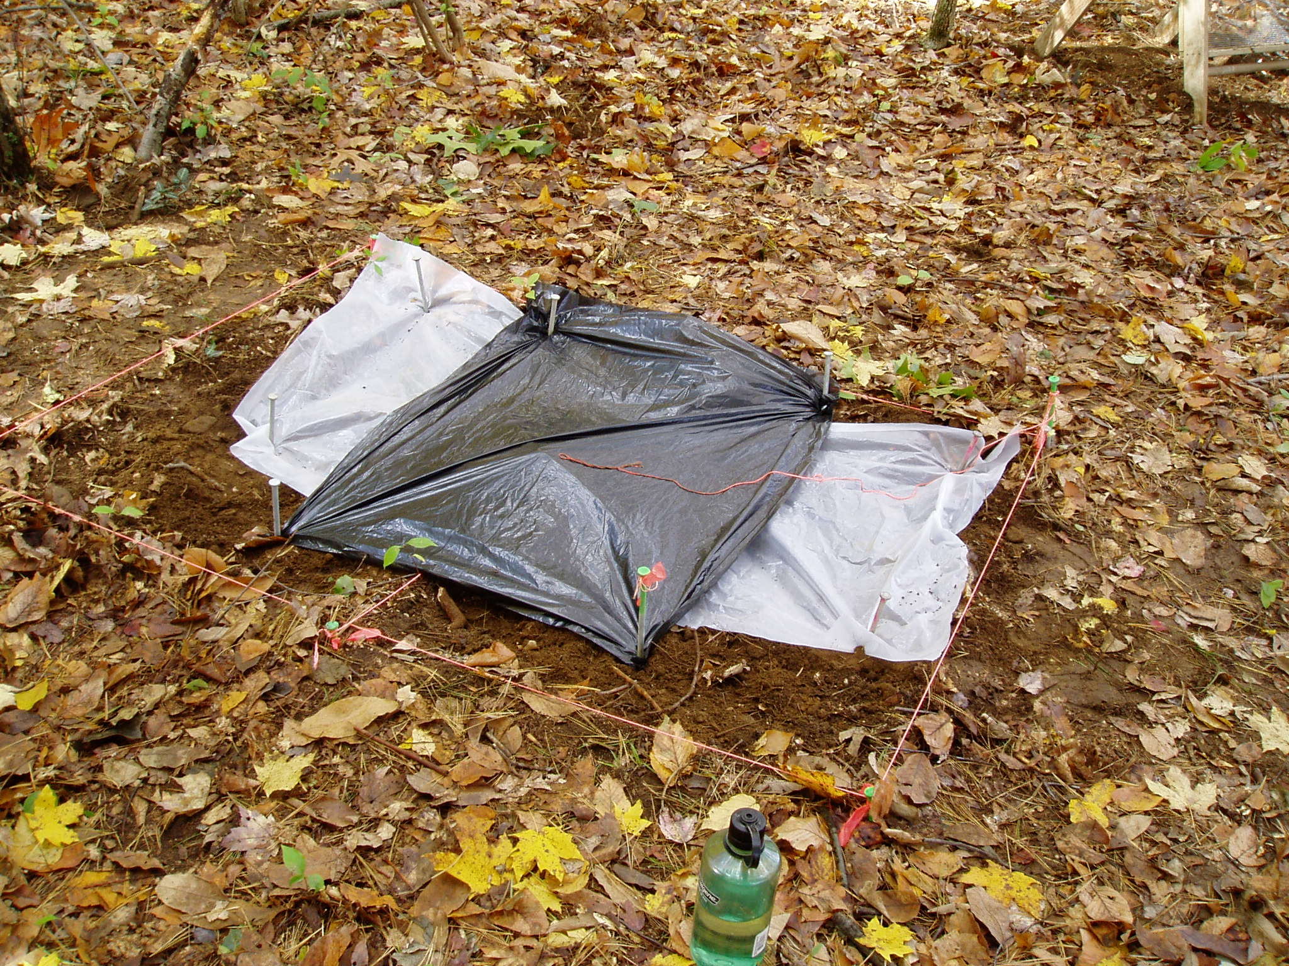
If the site needs to left overnight, it must be covered. This protects it from scavengers, rain, and “whatever” else may interfere.
Notes:
45

