Slide 1
Forensic Psychiatry
Ch 29
Pages 593-602

Slide 2
I. Definition
1. Forensic Psychiatry is a subspecialty of psychiatry that deals with people who are involved in legal matters, either criminal or civil
Primarily assessment and evaluation of individuals, rather than the treatment of psychiatric patients

Slide 3
II. History of Forensic Psychiatry
Treatise of Medical Jurisprudence of Insanity, published in Boston, MA in 1838 by Isaac Ray
Proliferated in the 1960’s/1970’s
2. Psychiatrists became more involved in commitment procedures, changes in patient rights, and protecting the public through rulings in various states

Slide 4
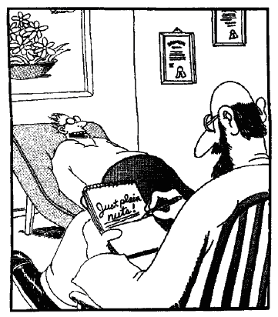
III. Scope of Forensic Psychiatry
1. Field of forensic psychiatry may be divided into three major sub groupings:
Criminal forensic psychiatry
(ability to stand trial, legal insanity, sentencing issues, treatment of a mentally ill offender)
Civil forensic psychiatry
(personal injury cases, domestics, competency)
Administrative forensic
psychiatry
(confidentiality, privileged communications, privacy issues, patient rights)

Slide 5
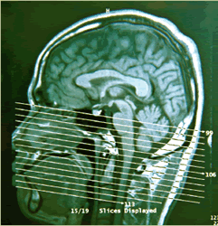
IV. Assessment of Competency
1. In general, forensic psychiatrist is called upon to assess an individual’s mental state in one of three ways:
Past – legal insanity or testamentary capacity
Present – competency to stand trial
Future – Prediction of dangerousness

Slide 6
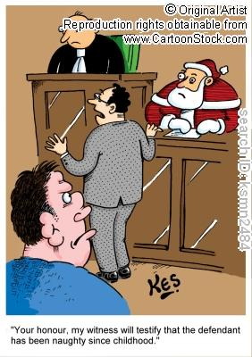
a. Phases of Criminal Procedure
2. Three phases of criminal procedure:
Pretrial phase
(asses defendant for competency to confess, give statement, to testify, or stand trial)
Trial phase
(mental state of the defendant at the time of the offense)
Post trial Phase
(assessing the information given to the court, sentencing, considered dangerous?)

Slide 7
b. Competency to Stand Trial
3. To be found competent to stand trial, a defendant must be free of mental illness that impacts his or her ability to know what is happening in the case
The Dusky case (1960) insists a defendant must have a rational as well as factual understanding of the case against him
Jackson v. Indiana (1972) – defendant committed to a civil hospital after charges were suspended and case treated as civil rather than criminal
After a period of time, psychiatrist may be asked by court to give an opinion about whether defendant is competent to stand trial

Slide 8
c. Legal Insanity
4. Most states follow McNaughten (1843) rule from England to determine sanity
McNaughten rules are a cognitive test of insanity
5. Model Penal Code of the American Law Institute states:
“A person would be found not guilty by reason of insanity if at the time of the commission of the crime the person lacked substantial capacity either to appreciate the criminality of their behavior or to conform his conduct to the requirements of the law.”

Slide 9
Some states have adopted the “guilty but mentally ill” concept
Pennsylvania and 13 states have adopted this concept
Plea is “guilty but mentally ill” instead of “not guilty by reason of insanity”

Slide 10
d. Diminished Capacity
6. Generally acknowledged as an individual at time of commission of the alleged offense having a diminished ability to meet all criteria for the charges against that person, or person was not able to form the specific intent to kill, thus could not act in a knowing and purposeful manner
In most cases, in terms of homicide, drops it from 1st degree to 3rd degree

Slide 11
e. Posttrial Sentencing
7. Forensic psychiatrist may be called
upon to give opinions about sentencing for particular individual who may require psychiatric hospitalization
For death penalty cases, …as to whether or not defendant is competent to be sentenced to death

Slide 12
f. Cases Requiring Psychiatry Treatment
8. Forensic psychiatrist may need to assess the role of alcohol, medication or legal drugs on defendant at time of commission of the crime
Issue of repressed or recovered memory may be assessed by psychiatrist

Slide 13
g. Examination and Report of Findings
9. In domestic relations crimes, psychiatrists may be called upon to discuss “syndrome diagnoses” such as rape trauma or battered spouse syndrome

