Slide 1
The Role of the Forensic Pathologist
Ch 2
Pages 15-24

Slide 2
Terminology
Pathology – medical specialty dealing with the diagnosis of disease by examining tissues and fluids.
Firearm – heat engine that converts the chemical energy of a propellant into kinetic energy of a projectile.
Cause of death – disease or injury that initiates the lethal chain of events leading to death.

Slide 3
Incised wounds – injury produced by a sharp instrument and characterized by lack of surface abrasion and absence of bridging vessels, nerves and smooth margins
Autopsy - a medical procedure that consists of a thorough examination of a human corpse to determine the cause and manner of a person's death and to evaluate any disease or injury that may be present.
Rigor mortis – stiffening of the body after death due to the chemical breakdown of actin-myosin and the depletion of glycogen from muscles. A time-dependent change that helps determine time of death.

Slide 4
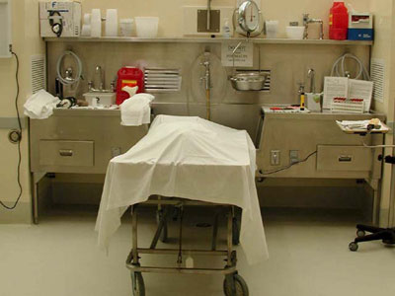
I. Introduction
A death that is sudden, unexpected or is thought to have been caused by injury or poison (suspicious) is always investigated for the purpose of determining whether it was a homicide.

Slide 5
II. The Coroner and Medical Examiner Systems
1. Coroner System
the coroner is usually the government agent charged with responsibility for death investigations.
usually in rural areas
2. Medical Examiner System
in recent years laws have established medical examiners and this development eliminated or weakened the position of the coroner.
In larger, commercial cities

Slide 6
III. Training Requirements for a Forensic Pathologist
1. A Pathologist studies disease, its causes and its diagnosis.
2. Anatomic Pathologists performed autopsies and examined tissues, while Clinical Pathologists managed laboratories where body fluids were tested.
3. Forensic Pathology was brought about by the need for autopsies to determine the causes of deaths of people who died suddenly and unexpectedly.
the medical examiner is required to be a forensic pathologist also handle autopsies for coroners in the rural areas

Slide 7
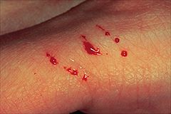
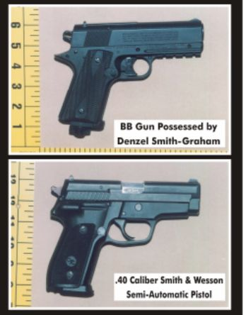
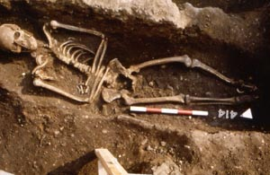
4. Many forensic pathologists undertake training in broader areas of forensics such as:
toxicology
serology,
tool mark examination,
firearm examination,
crime scene analysis,
forensic anthropology
forensic odontology

Slide 8
IV. Duties of a Forensic Pathologist
#1 Review Medical History
medical history is the starting point for any investigation
in a death investigation, 2 questions must be answered. Is the death sudden? Is the death unexpected?
Careful study of medical records is required to properly determine the causes and manners of death of persons with histories of trauma
review of medical history is extremely important in situations where people have been treated after injuries.

Slide 9
#2 Review Witness Statements
-this information helps determine jurisdiction in cases where injury is not obvious.
-is extremely valuable in developing questions to be answered.
#3 Scene Examination
- in the best of situations a forensic pathologist will examine the scene of death or the location where the body was found in every case they investigates
- a forensic pathologist can answer questions about post injury movement, time between injury, time of death, and what exactly happened to cause death

Slide 10
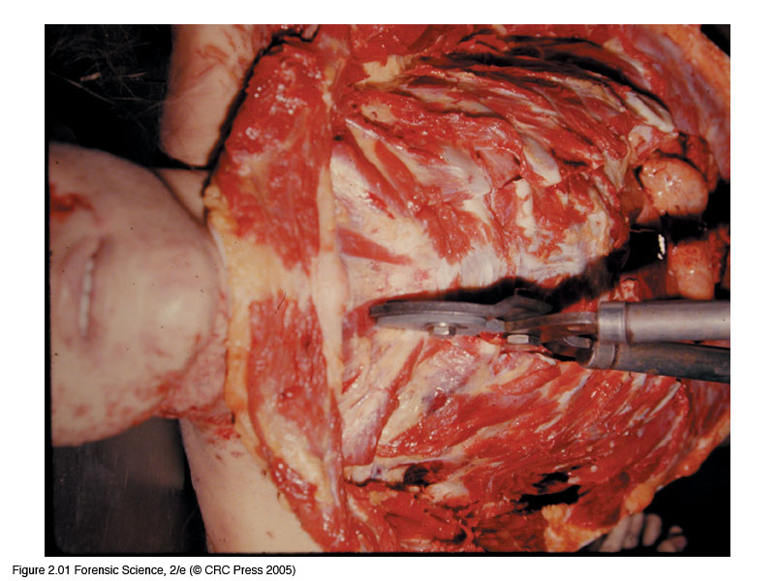
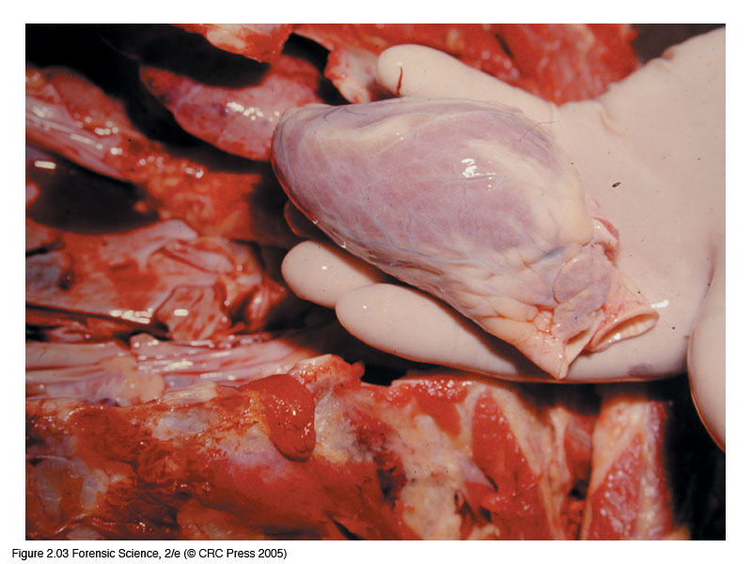
#4 - Autopsy Examination
- the dissection of the human body to determine cause of death
- requires permission of the surviving next of kin as long as they are not suspected of causing the death
- generally entails the removal, through incisions, of the organs of the chest, abdomen and head.
- Organs may be dissected right away, or ‘fixed’ in a solution of formaldehyde, causing the proteins to harden; that preserves the tissue and prevents further decomposition

Slide 11
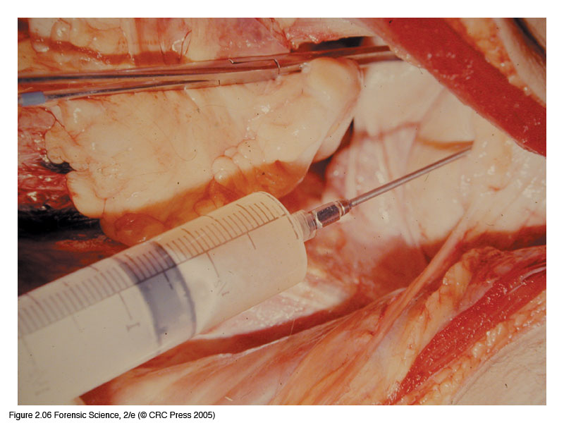
V. Obtaining Appropriate Specimens
1. Toxicology
Specimens removed for toxicology testing are urine, blood, and bile.
to determine the presence of drugs of abuse
2. Microscopic Examination
further study of internal organs
3. DNA Analysis
2 methods of obtaining DNA samples: blood and hair, are use for future DNA analysis

Slide 12
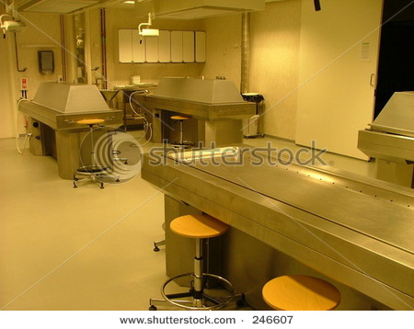
VI. Photograph
Taking and preserving photographs of the scene and the autopsy are important duties of a forensic pathologist
Ensure that relevant and admissible photos are taken

Slide 13
VII. Report Preparation
A written report of each autopsy is customary
Sometimes the autopsy will be dictated
Final summary of the external examination, internal dissections, microscopic examinations, and a toxicology report

Slide 14
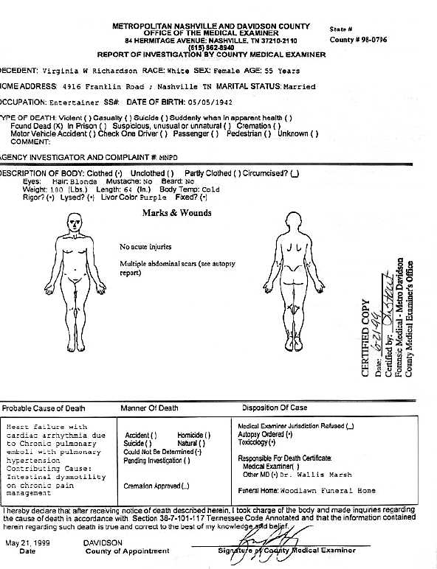

Slide 15
VIII. Testimony
1. Forensic Pathologists spend vast amounts of their time testifying about their findings and opinions
Is required to prosecute a defendant for manslaughter or murder
In civil courts for wrongful death suits
2. Forensic Pathologists often testify as expert witnesses in cases in which they did not actually examine the body of the deceased.

